Slide 1
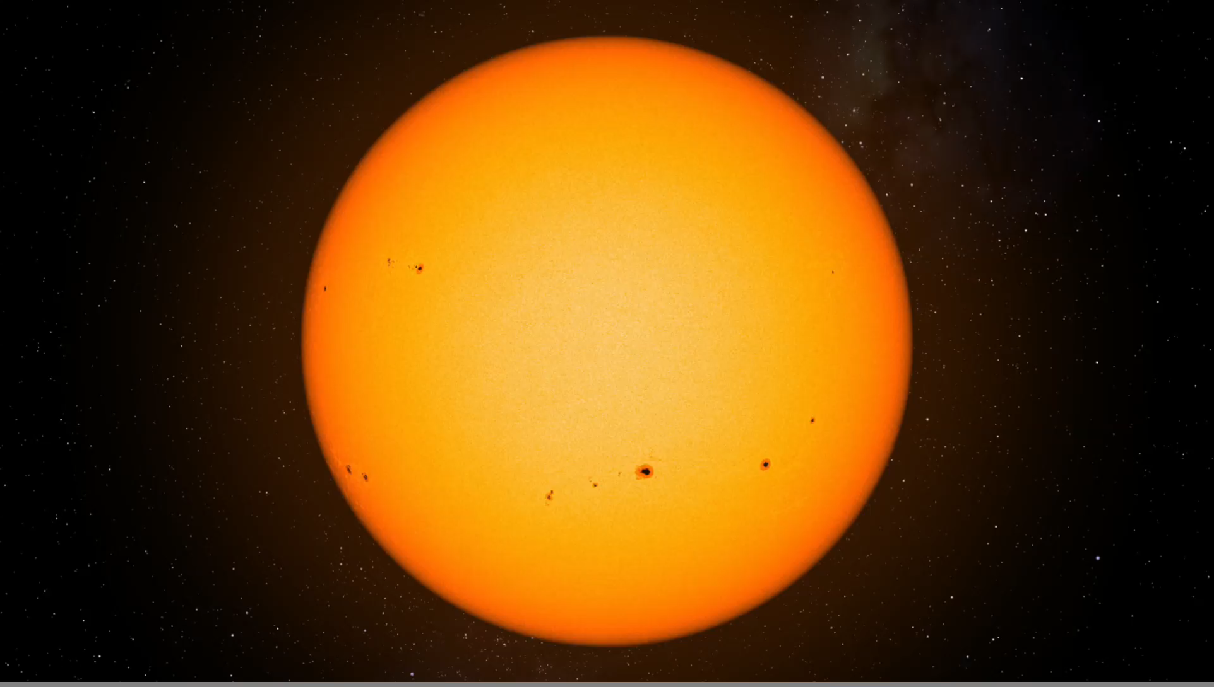


The art of Stokes inversions
Basilio Ruiz Cobo
Instituto de Astrofísica de Canarias, Spain
Boulder (CO) 15-26 May 2017

Slide 2
Inversion techniques, or Inversion methods are numerical tools that allow us to infer some free parameters of a model from an image
Model
Known parameters
Free parameters
Direct: Known function
Image (Observables)
Inversion
Inverse Problems (1995) Vol 11, number 4 : Inverse Problems in Astronomy
Inverse Problems in Astronomy (1986) Craig & Brown CRC Press
The first paper: Victor Ambartsumian (1929) Zeitschrift für Physik 53, 690
Goncharskiy, Cherepashchuk and Yagola (1978) Numerical methods of solving inverse problems in astrophysics
Helioseismology
Solar Physics
Spectropolarimetry (Inversion of RTE for polarized light)

Slide 3
Outline
PART 1: Theory
1. The RTE: formal solution & approximations
2. The Response Functions
3. What is an inversion technique? How does it work?
4. The SIR code.
5. How to choose an inversion technique?
6. Running SIR
PART 2: SIR exercises

Slide 4


Download
Download SIR code from:
https://github.com/BasilioRuiz/SIR-code
And these slides and exercises from:
https://github.com/BasilioRuiz/SIR-course
3rd SOLARNET School, 18-23 May 2015, Granada, Spain Luis Bellot Rubio

Slide 5
1: The RTE: formal solution & approximations
RTE:

Slide 6
1: The RTE: formal solution & approximations
RTE:
Absorption coefficient: χ_{ν} = ( χ_{ff +} χ_{bf} ) + χ_{bb} φ(ν)
χ_{c}
Emission: η_{ν}
Optical depth: dτ_{ν}= − χ_{ν} ds
Continuum optical depth: dτ_{c}= − χ_{c} ds
Suppose no emission :

Slide 7
1: The RTE: formal solution & approximations
RTE:
Absorption coefficient: χ_{ν} = ( χ_{ff +} χ_{bf} ) + χ_{bb} φ(ν)
χ_{c}
Emission: η_{ν}
Optical depth: dτ_{ν}= − χ_{ν} ds
Continuum optical depth: dτ_{c}= − χ_{c} ds
Suppose no emission :

Slide 8
1: The RTE: formal solution & approximations
RTE:
Absorption coefficient: χ_{ν} = ( χ_{ff +} χ_{bf} ) + χ_{bb} φ(ν)
χ_{c}
Emission: η_{ν}
Optical depth: dτ_{ν}= − χ_{ν} ds
Continuum optical depth: dτ_{c}= − χ_{c} ds
Suppose no emission :
Optical depth: dτ_{ν}= − χ_{ν} ds (number of mean free paths at ν)
Continuum optical depth: dτ_{c}= − χ_{c} ds (number of mean free paths at continuum)
Suppose no emission :

Slide 9
1: The RTE: formal solution & approximations
RTE:
Continuum optical depth: dτ_{c}= − χ_{c} ds

Slide 10
1: The RTE: formal solution & approximations
RTE:
Continuum optical depth: dτ_{c}= − χ_{c} ds

Slide 11
1: The RTE: formal solution & approximations
RTE:
Continuum optical depth: dτ_{c}= − χ_{c} ds
S_{ν}
per cm
cm²/ g

Slide 12
1: The RTE: formal solution & approximations

Slide 13
1: The RTE: formal solution & approximations
Formal solution: integration factor O

Slide 14
1: The RTE: formal solution & approximations
Formal solution: integration factor O

Slide 15
1: The RTE: formal solution & approximations

Slide 16
1: The RTE: formal solution & approximations

Slide 17
1: The RTE: formal solution & approximations
, depend on the atomic populations n=n[T, P, )] SE equations
Some possible approximations:
LTE: n=n[T, P] &
Milne- Eddington (ME) approximation: =cte,

Slide 18
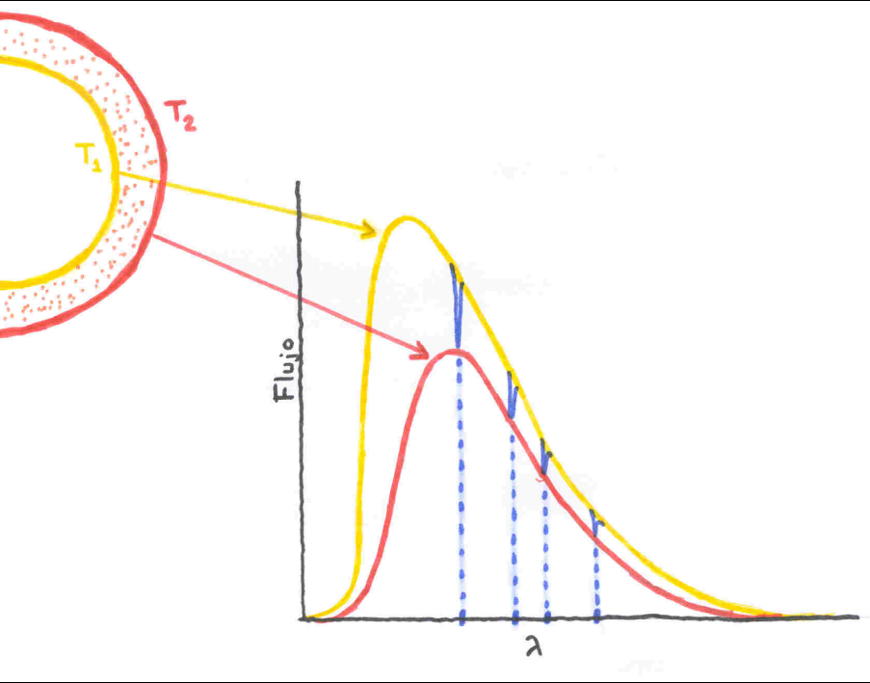
1: The RTE: formal solution & approximations
Spectral lines: Temperature gradient
Negative gradient: absorption lines
Positive gradient: emission lines
Core: upper layers
Wings, Continuum: deeper layers

Slide 19
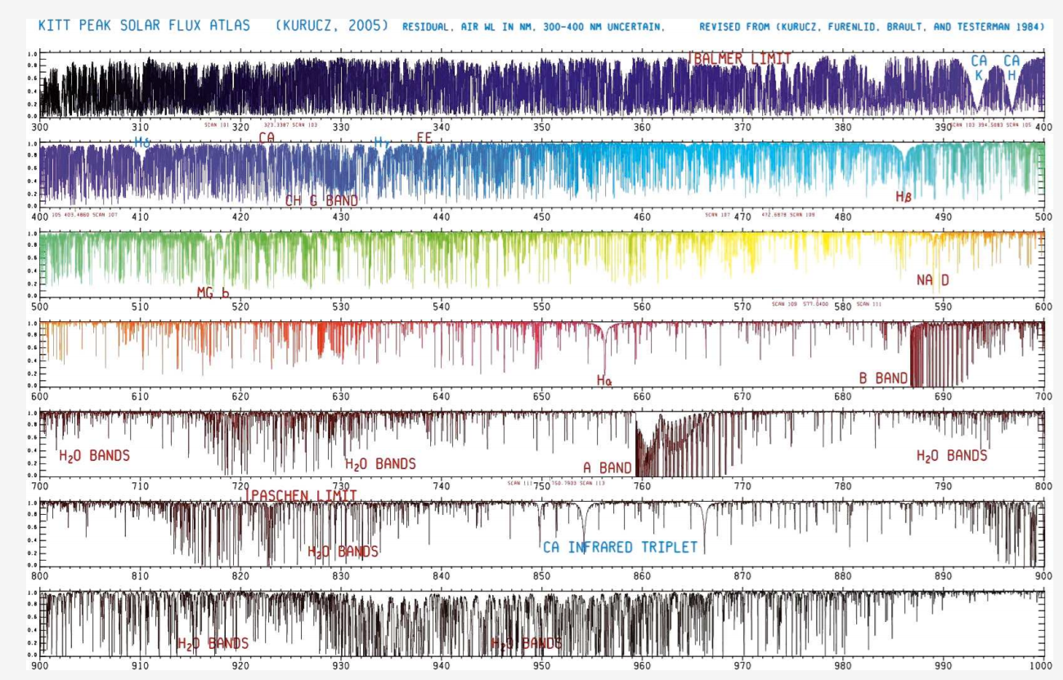

Slide 20
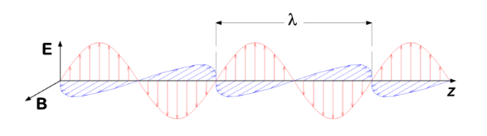
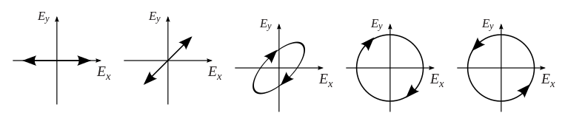
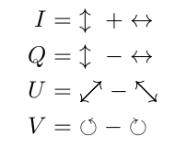
1: The RTE: formal solution & approximations

Slide 21
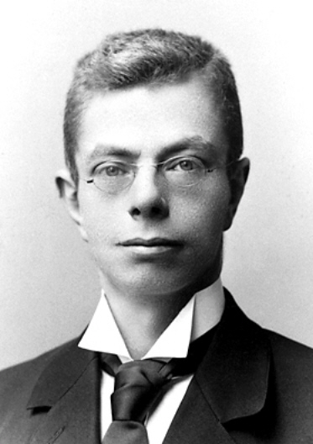
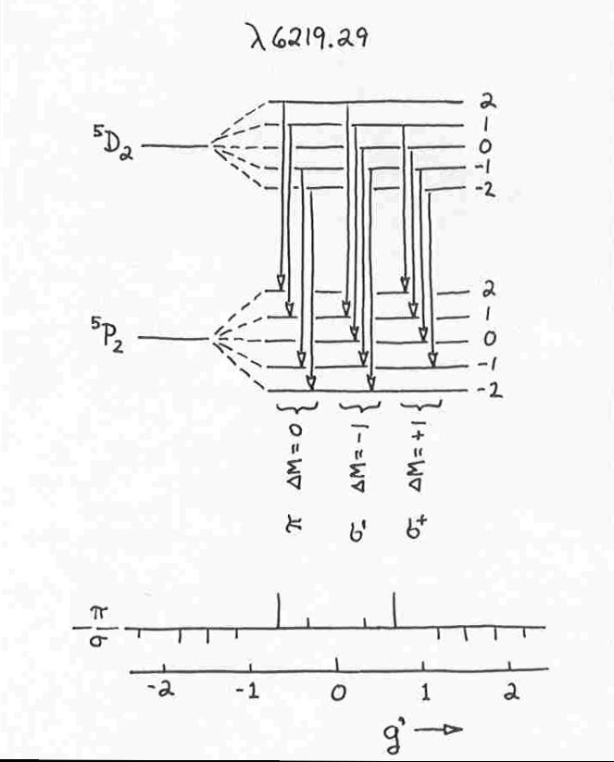
1: The RTE: formal solution & approximations
Pieter Zeeman (1865-1943)

Slide 22
1: The RTE: formal solution & approximations

Slide 23
1: The RTE: formal solution & approximations
2000 G, 45º

Slide 24
1: The RTE: formal solution & approximations
2000 G, 45º

Slide 25
1: The RTE: formal solution & approximations

Slide 26
1: The RTE: formal solution & approximations
Landi Degl’Innocenti & Landi Degl’Innocenti (1981)

Slide 27
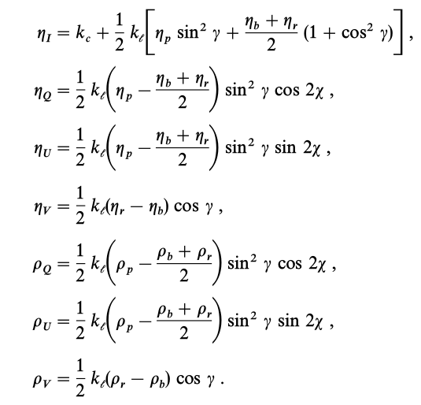
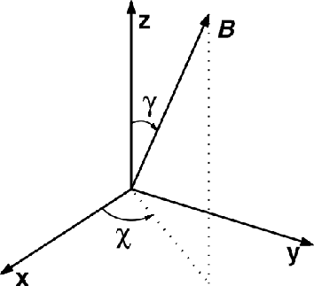
1: The RTE: formal solution & approximations
Landi Degl’Innocenti & Landi Degl’Innocenti (1981)
Landi Degl’Innocenti & Landolfi (2004) Polarization in Spectral lines

Slide 28
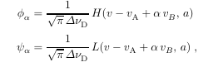
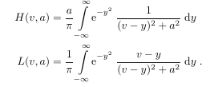
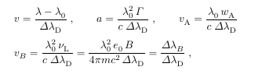
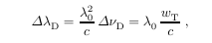
1: The RTE: formal solution & approximations
η_{α}=
ρ_{α}=
Landi Degl’Innocenti & Landi Degl’Innocenti (1981)
Landi Degl’Innocenti & Landolfi (2004) Polarization in Spectral lines

Slide 29
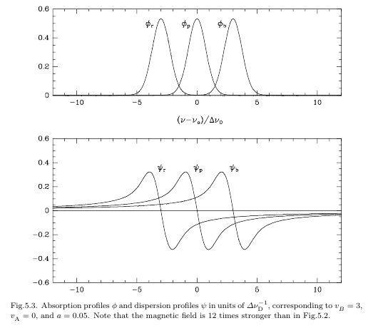
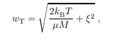
1: The RTE: formal solution & approximations
Landi Degl’Innocenti & Landi Degl’Innocenti (1981)

Slide 30
1: The RTE: formal solution & approximations

Slide 31
2: The Response Functions
Landi Degl’Innocenti & Landi Degl’Innocenti (1977) A&A 56, 111
Ruiz Cobo & del Toro Iniesta (1994) A&A 283,129
&
depend on atmosphere
Can we evaluate, in first order, how much change when we perturb x= ?

Slide 32
2: The Response Functions
Landi Degl’Innocenti & Landi Degl’Innocenti (1977) A&A 56, 111
Ruiz Cobo & del Toro Iniesta (1994) A&A 283,129
&
depend on atmosphere
Can we evaluate, in first order, how much change when we perturb x= ?

Slide 33
2: The Response Functions

Slide 34
2: The Response Functions

Slide 35
2: The Response Functions

Slide 36
2: The Response Functions

Slide 37
2: The Response Functions

Slide 38
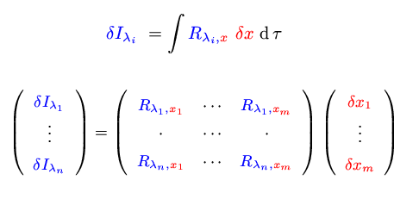
2: The Response Functions
Table of physical magnitudes
+ atomic parameters
+ scenario
+ approximations
+ physical laws
Synthesis
(solving RTE)
&

Slide 39
3. What is an inversion technique? How does it work?
Any method used to infer the physical conditions of the atmosphere from the interpretation of Stokes profile.
(in a broad sense any “measurement in the Sun” is an inversión)
We want: vector magnetic field, gas temperature, gas velocity, etc, at some layers in the Sun
We need: assume some approximations. We will only be able to find some free parameters values such that we can reproduce the observations.

Slide 40
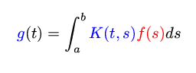
3. What is an inversion technique? How does it work?
-What’s an IT?
Inhomogeneous Fredholm’s ec. of the first kind:
g(t) data
K(t,s) kernel
f(s) unknown
This equation, through a quadrature, becomes:
K f = g
as g is no null if we could evaluate K ⁻¹
the solution: f = K ⁻¹ g but… this is not the general case

Slide 41
3. What is an inversion technique? How does it work?
f(s) become smoothed by the kernel K(t,s)
1) Small g(t) perturbations are compatible with huge changes in f(s)
2) Smoothing means lost information, then “recover” f(s) is imposible
3) We have a discrete set of g(t) values and we’d wish a function f(s)

Slide 42
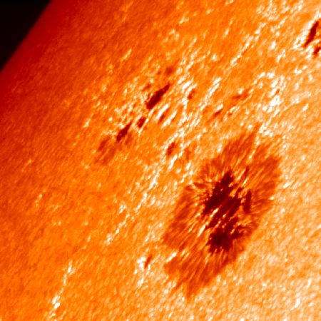
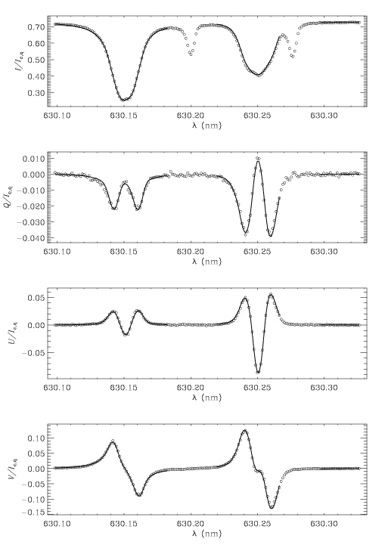
3. What is an inversion technique? How does it work?
Observation

Slide 43
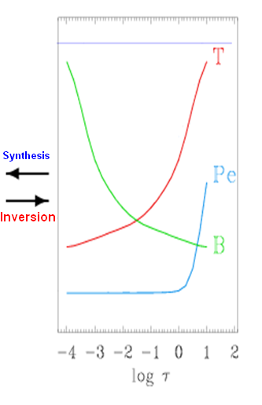
3. What is an inversion technique? How does it work?
MODEL
Approximations:
Atomic parameters
Plasma Physics ecs
stationary
plane-paralel
LTE
HE…
+

Slide 44
3. What is an inversion technique? How does it work?
The model (except free parameters values ) must be known a priori
We only fit the free parameters
Observation
MODEL
Approximations:
Atomic parameters
Plasma Physics ecs
+
stationary
plane-paralel
LTE
HE…

Slide 45
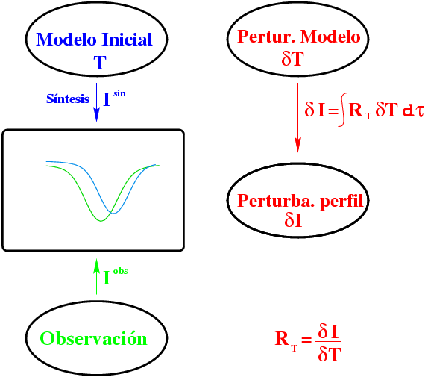
4: The SIR code
Initial model
T
Model perturbation
δT
Synthesis I^{syn}
Profile perturbation
I^{obs}
Observation

Slide 46
4: The SIR code
Initial model
T
Model perturbation
δT
Synthesis I^{syn}
Prof. perturb.
= I^{syn}-I^{obs}
I^{obs}
Observation

Slide 47
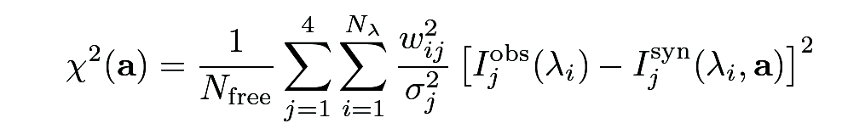
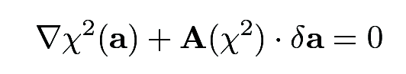
4: The SIR code
Inversion driven by χ²-minimization
Minimization: 2nd order Levenberg-Marquardt algorithm

Slide 48
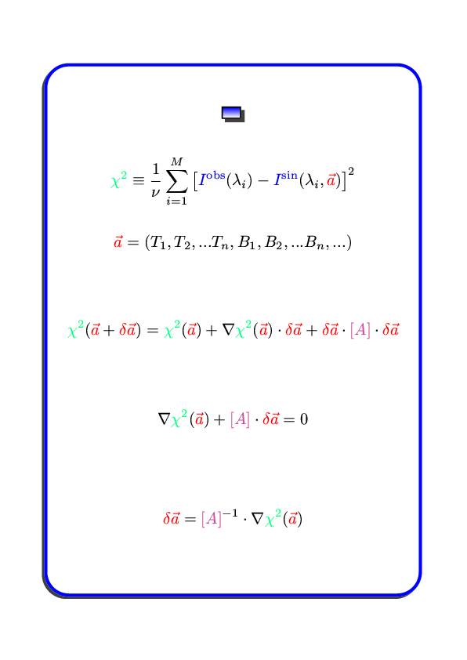
4: The SIR code
Least squares
= -

Slide 49
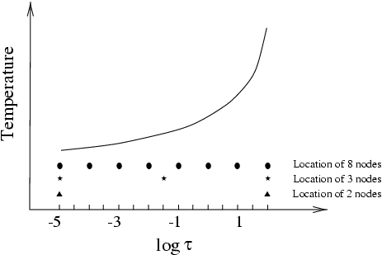
4: The SIR code
Very large (1)
Singular (2)
inverting A
1) Sequential increase of unknown number

Slide 50
4: The SIR code
Very large (1)
Singular (2)
inverting A
1) Sequential increase of number of unknowns
2) Singularities elimination through SVD (Singular Value Decomposition)
A = U W V ^{T} with U & V ortonormal matrix
y W =diagonal(W_{j j} )
A⁻¹= V W ⁻¹ U ^{T} with W ⁻¹ =diagonal(1/W_{j j} )
but doing (W ⁻¹ )_{j j} =0 si W_{j j} ≅ 0

Slide 51
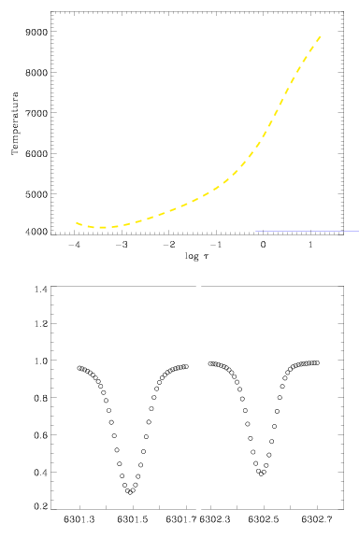
4: The SIR code
The “real” SUN
Synthetic “observations”

Slide 52
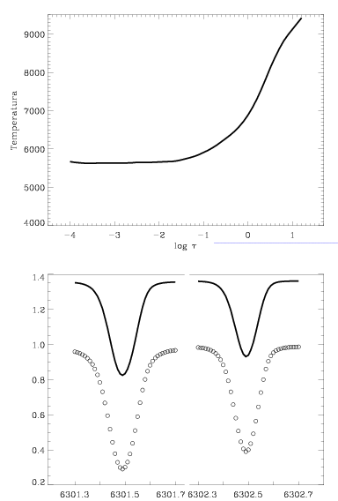
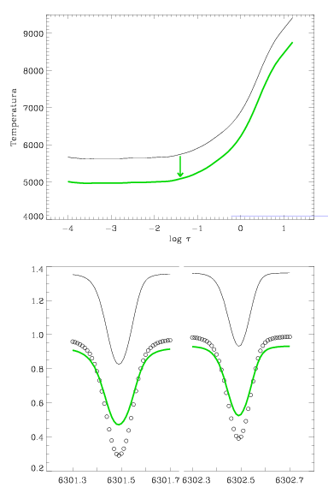
4: The SIR code
Initial guess model

Slide 53
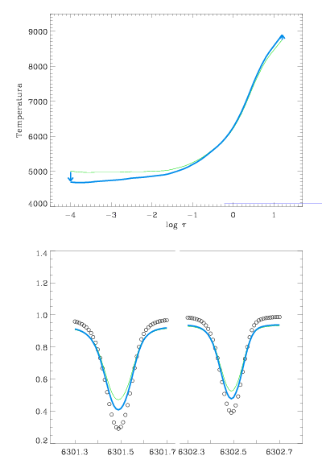
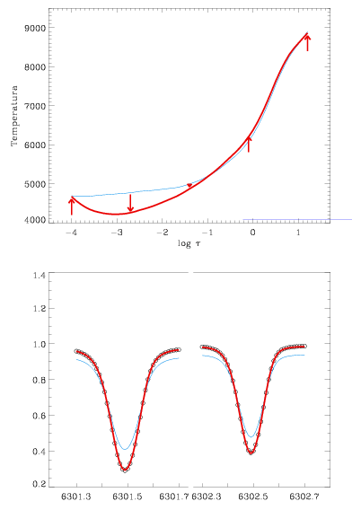
4: The SIR code

Slide 54
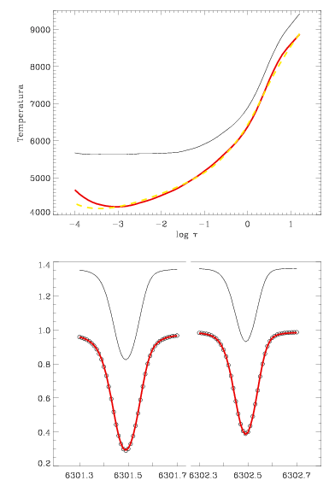
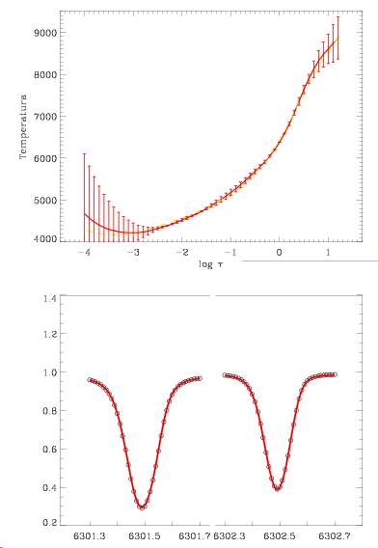
4: The SIR code

Slide 55
4: The SIR code
at node j
Equivalent Response Function at nodes

Slide 56
4: The SIR code
Parameters at nodes
Levemberg-Marquardt
+
SVD
Numerical Recipes (2007) Press et al.

Slide 57
4: The SIR code
Error bars:
Uncertainties:

Slide 58
4: The SIR code
Unicity?

Slide 59
4: The SIR code
Unicity?

Slide 60
4: The SIR code
Unicity?

Slide 61
4: The SIR code
Unicity?

Slide 62
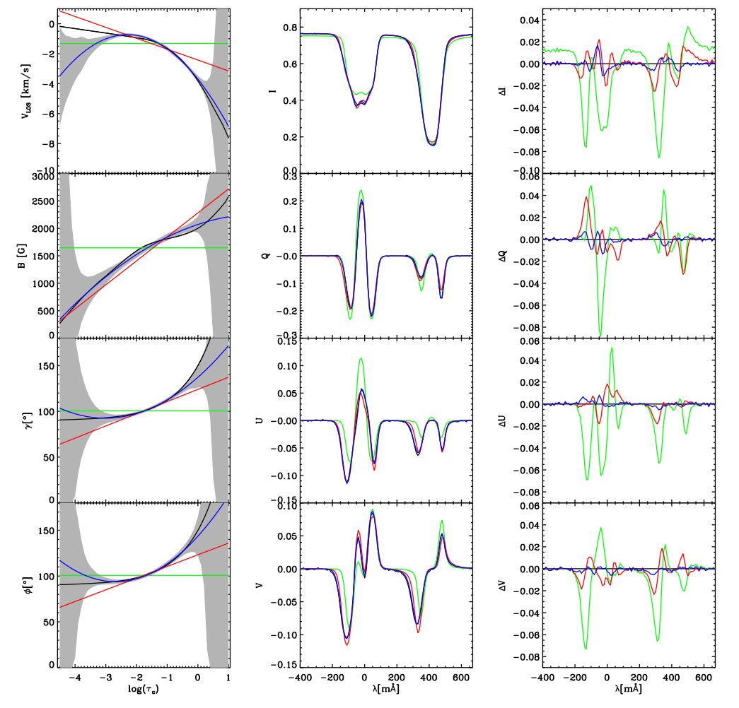
nodes(T, B)
2,1
4,2
6,3
Observation

Slide 63
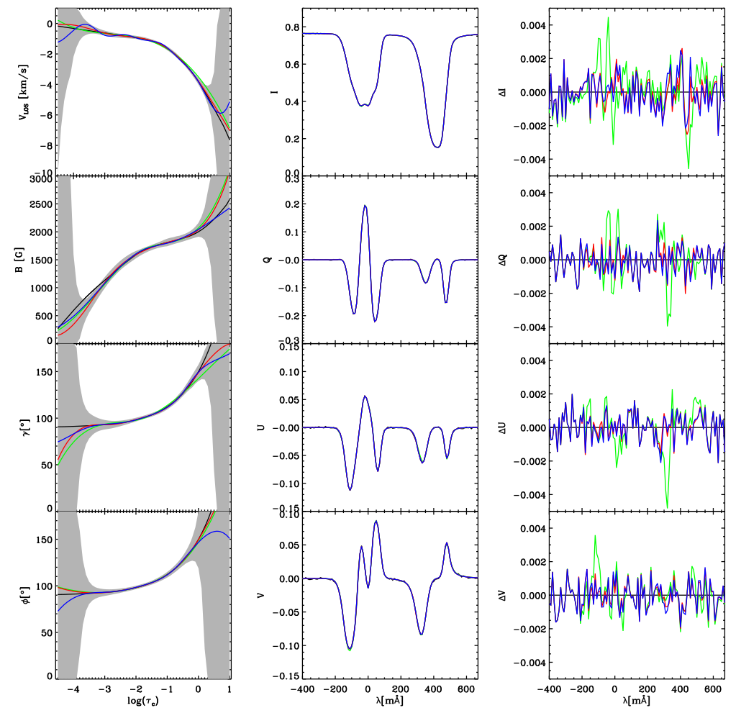
nodes(T, B)
7,5
9,7
Automatic
Observation

Slide 64
5: How to choose an inversion technique?
Some Reviews:
Socas Navarro (2001) ASP Conf Series 236, 487
del Toro Iniesta (2003) Astronomische Nachrichten 324, 383
Bellot Rubio (2006) ASP Conf Series, 358, 107
Ruiz Cobo (2007) ‘Modern Solar Facilities’, Göttingen
Asensio Ramos et al (2012) ApJ 748, 83
del Toro Iniesta & Ruiz Cobo (2016) Livings Reviews in Solar Physics, 13,4

Slide 65
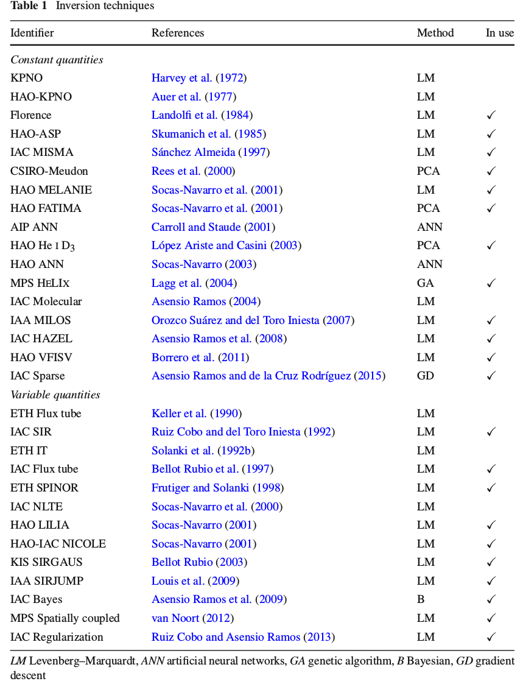
5: How to choose an inversion technique?

Slide 66
5: How to choose an inversion technique?

Slide 67
5: How to choose an inversion technique?
People usually select an inversion method for strange reasons: if the code is available, if it is easier or faster than others, (or was written for my boss), etc., instead of selecting the most convenient for each specific problem.
I classify available IT in 3 families:
ME must be used in case in which you do not know the physics controlling the line formation, or you have few wavelength points for each pixel.
PCA when you need fast results.
SIR (or similar) when you believe that your knowledge of the formation of the lines used is appropriate (and/or you be plenty of time or you be… a little crazy.)

Slide 68
5: How to choose an inversion technique?
ME family
Advantages:
- Fast (a typical map takes ~ hr).
- Simple use & easy interpretation of results.
- Robust & reliable.
- HE, LTE etc approximations are not needed.
Shortcoming:
- Unable to fit asymmetric Stokes profiles. (but: robust against noise)
- No gradients. (but: even theoreticians understand the results)
- No temperature, pressure & density information.
(but: no physics knowledge is required)
- The number of free parameter grows with the number of spectral lines
(but: no excuses!)

Slide 69
5: How to choose an inversion technique?
2. SIR family
Advantages:
- Arbitrarily complex along line of sight (gradients, multicomponents, etc)
- Thermodynamic information.
- Adaptation to many geometries & scenarios.
- LTE/NLTE, HE, mass conservation etc.
- Uncertainties estimation.
Shortcoming:
- Slow (20-30 times slower than ME)
(but: new SIR version –upcoming soon!!- will nearly reach ME rates)
- Difficult use
(but: for simplified problems –like only linear stratifications-- is straightforward)
- Unicity
(but: only if you are ambitious)

Slide 70
5: How to choose an inversion technique?
3. PCA family
Look-up-table inversion method, based in PCA
Since 2004 used in THEMIS for real-time inversions
Advantages: - extremely fast (one order of magnitude faster than ME)
- simple use, robust & reliable
Shortcoming: - few free parameter determination (ME)
- slightly more inaccurate that ME inversions

Slide 71
Conclusions
5: How to choose an inversion technique?
ME must be used in case in which you do not know the physics controlling the line formation or few spectral points, and you need fast results.
PCA when you need extremely fast results.
SIR (or similar) when you believe that your knowledge of the formation of the lines used is appropriate.

Slide 72
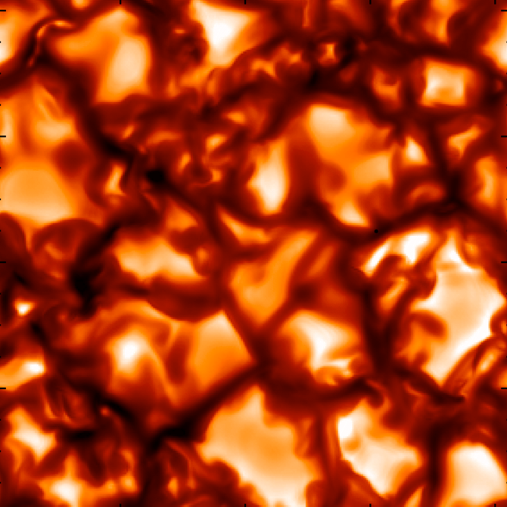
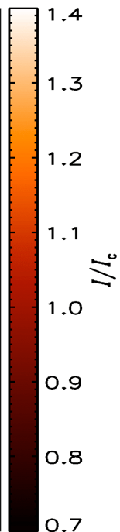
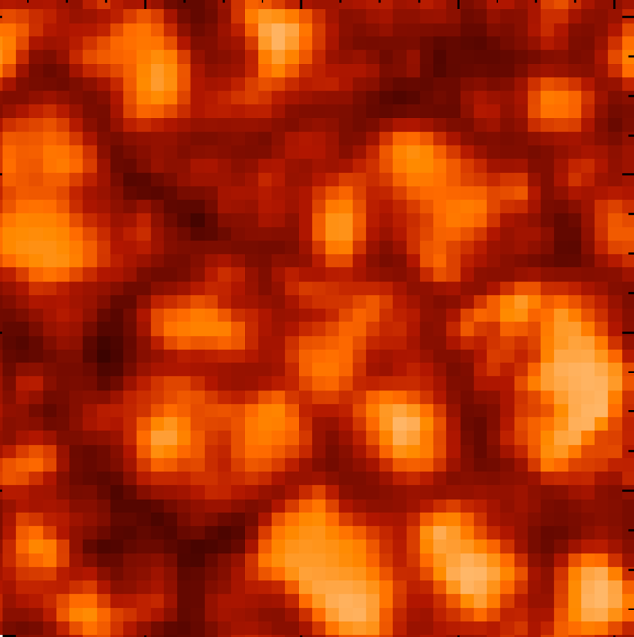
5: How to choose an inversion technique?
ME inversions of high-spatial resolution profiles
MHD simulations (Vögler et al. 2005)
• Fe I 630.1 and 630.2 nm profiles degraded to Hinode/SP resolution and pixel size
Luis Bellot Rubio

Slide 73
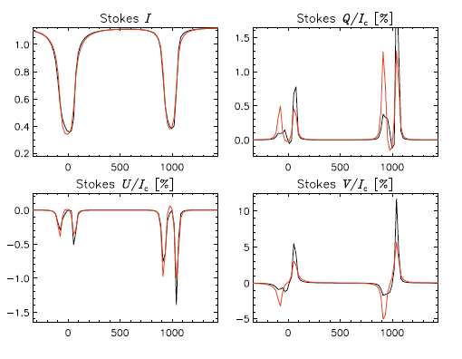
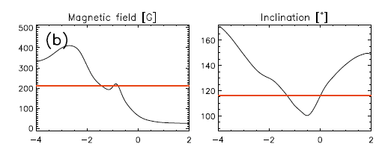
5: How to choose an inversion technique?
ME inversions of high-spatial resolution profiles
MHD simulations (Vögler et al. 2005)
+
ME inv
Profiles reasonably well fitted
ME results are some kind of “average” of physical parameters along the LOS
ME inv
Luis Bellot Rubio

Slide 74
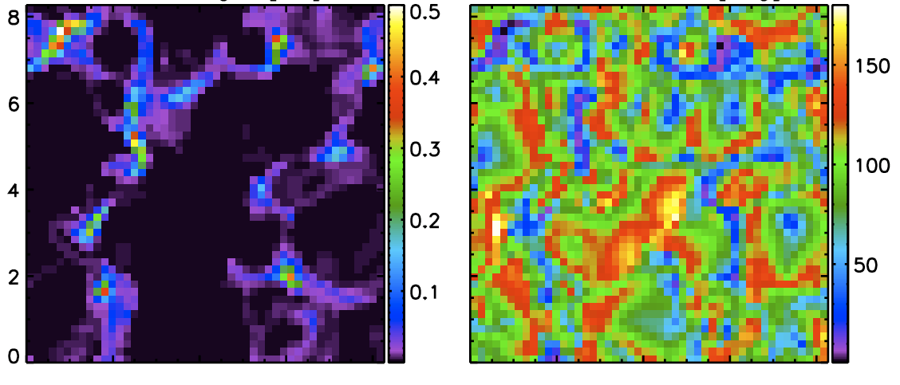
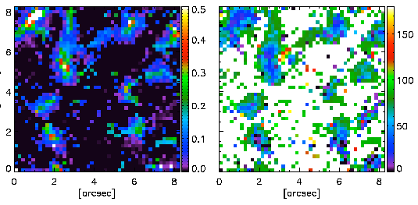
5: How to choose an inversion technique?
ME inversions of high-spatial resolution profiles
MHD simulations (Vögler et al. 2005)
Magnetic field strength
Field inclination
Inferred field strength
Inferred field inclination
Atmospheric parameters from MHD simulation at log τ = -2
Maps of inferred B and γ
similar to real ones!
Orozco Suárez et al. 2007, ApJ, 662, L31
Luis Bellot Rubio

Slide 75
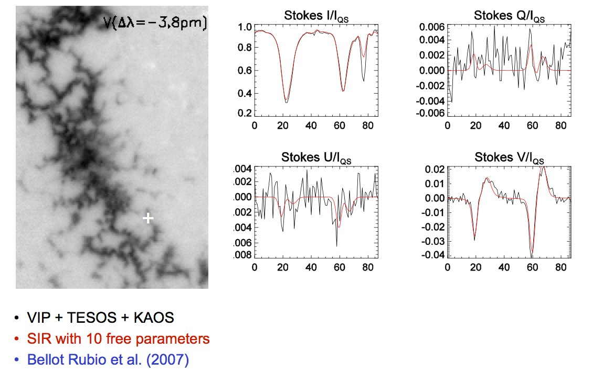
5: How to choose an inversion technique?
Asymmetric Stokes profiles
TESOS+VIP, Sep 2006
KIS/IAA Visible Imaging Polarimeter + TESOS + KAOS
VTT, Observatorio del Teide
Spatial resolution: ∼0.4"
Luis Bellot Rubio

Slide 76
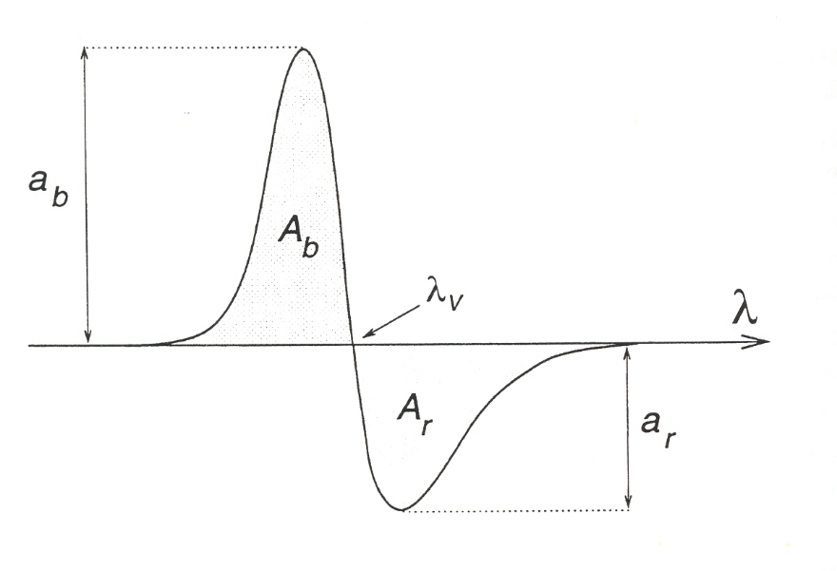
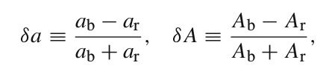
5: How to choose an inversion technique?
Asymmetric Stokes profiles
Basilio Ruiz Cobo

Slide 77




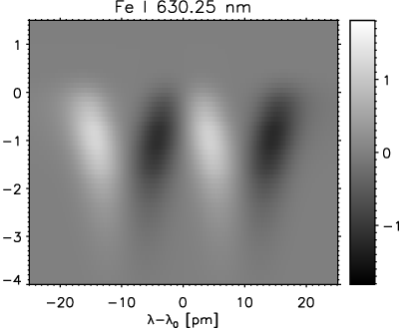
5: How to choose an inversion technique?
Asymmetric Stokes profiles
Amplitude asymmetry/ Multi-lobed Stokes profiles
Area asymmetry
Different magnetic atmospheres coexisting in resolution element
Gradients/discontinuities of B
and v_{LOS} along LOS
Auer & Heasley (1978)
RF of Stokes V to B
The area asymmetry gives information on the height variation of atmospheric parameters
Cabrera Solana et al. (2005)
Luis Bellot Rubio

Slide 78
5: How to choose an inversion technique?
Asymmetric Stokes profiles
Inversion codes capable of dealing with asymmetries
Are based on numerical solution of RTE
Provide reliable thermal information
(Can) use less free parameters than ME codes
Infer stratifications of physical parameters with depth
Luis Bellot Rubio

Slide 79
5: How to choose an inversion technique?
Asymmetric Stokes profiles
Luis Bellot Rubio

Slide 80
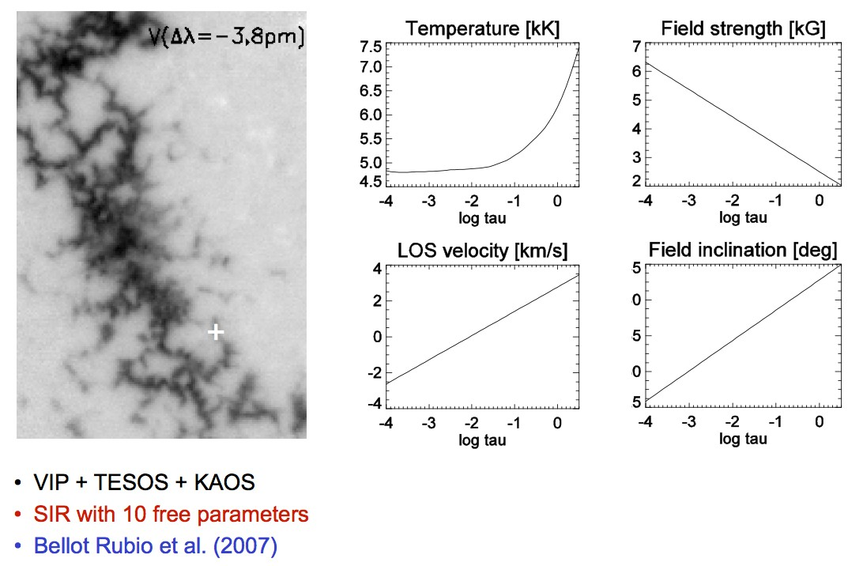
5: How to choose an inversion technique?
Asymmetric Stokes profiles
Luis Bellot Rubio

Slide 81
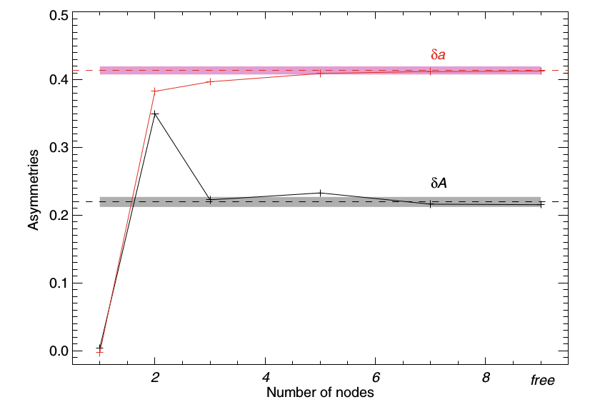
5: How to choose an inversion technique?
Asymmetric Stokes profiles
Basilio Ruiz Cobo

Slide 82
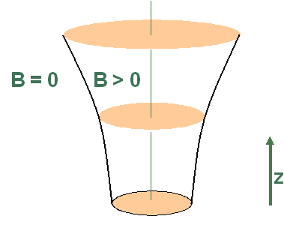
5: How to choose an inversion technique?
Asymmetric Stokes profiles
The results change if the physical model is changed
Too simplistic models; often they cannot describe the real atmosphere
BUT: we get information about the magnetic structure of the atmosphere!
2.5
2.0
1.5
1.0
0.5
0.0
Flux tube model
B [kG]
-5 -4 -3 -2 -1 0 1 2
log tau
Fe I 630.2 nm
1.0
0.9
0.8
0.7
0.6
0.5
0.10
0.05
I/I_{QS}
V/I_{QS}
0.00
Magnetic flux tubes in facular regions
-0.05
-0.10
-400
-200
0 200 400
-400 -200
0 200 400
Lambda [mA]
Lambda [mA]
Luis Bellot Rubio

Slide 83
5: How to choose an inversion technique?
Asymmetric Stokes profiles
The results change if the physical model is changed
Too simplistic models; often they cannot describe the real atmosphere
BUT: we get information about the magnetic structure of the atmosphere!
2.5
2.0
1.5
1.0
0.5
0.0
Flux tube model Best-fit 1C model
B [kG]
-5 -4 -3 -2 -1 0 1 2
log tau
Fe I 630.2 nm
11..00
00..99
00..88
00..77
00..66
00..55
00..1100
00..0055
II//II_{QQSS}
VV//II_{QQSS}
00..0000
Magnetic flux tubes in facular regions
--00..0055
--00..1100
-400
-200
0 200 400
--440000
--220000
00 220000
440000
--440000 --220000
00 220000
440000
Lambda [mA]
-400
-200
0 200 400
LLaammbbddaa [[mmAA]]
LLaammbbddaa [[mmAA]]
Lambda [mA]
Luis Bellot Rubio

Slide 84
5: How to choose an inversion technique?
Asymmetric Stokes profiles
The results change if the physical model is changed
Too simplistic models; often they cannot describe the real atmosphere
BUT: we get information about the magnetic structure of the atmosphere!
22..55
22..00
11..55
11..00
00..55
00..00
Flux tube model Best-fit 1C model
BB [[kkGG]]
--55
-5 -4 -3 -2 -1 0 1 2
log tau
Fe I 630.2 nm
--44
--33
--22 --11
lloogg ttaauu
00 11 22
Fe I 630.2 nm
11..00
00..99
00..88
00..77
00..66
00..55
00..1100
00..0055
II//II_{QQSS}
VV//II_{QQSS}
00..0000
--00..0055
--00..1100
-400
-200
0 200 400
--440000
--220000
00 220000
440000
--440000 --220000
00 220000
440000
Lambda [mA]
-400
-200
0 200 400
LLaammbbddaa [[mmAA]]
LLaammbbddaa [[mmAA]]
Lambda [mA]
Luis Bellot Rubio

Slide 85
Running SIR: input files
In the downloaded folders you can find a manual, in which it is described the menu, i.e. all the input/output formats and options for running SIR
Running a ME code is like have a dinner in Botswana: fast, unique & sure
Running SIR is like have a dinner in America: slow, a lot of freedom, but never know…

Slide 86

Running SIR: input files
All the program is control by a control file: [ ].trol
Number of cycles:
0 : Synthesis Mode
-1: Evaluate Response Function at every depth
-2: Evaluate Response Function at the nodes
>0: Number of cycles of the inversion

Slide 87

Running SIR: input files
Profile file: [ ].per
Input files
Line Δλ
index [mA]
I/I
Q/I U/I_{qs} V/I_{qs}
qs
qs
read_profiles.pro write_profiles.pro

Slide 88
Running SIR: input files
Profile file: [ ].per
Input files
Values lower than -1 for any Stokes at any wavelength will not be consider in the χ²
Line Δλ
index [mA]
I/I
Q/I U/I_{qs} V/I_{qs}
qs
qs
read_profiles.pro write_profiles.pro

Slide 89
Running SIR: input files
All the program is control by a control file:
Stray light file: The file (with the same format as a profile file) containing the stray light contamination

Slide 90
Stray-light considerations
Stray-light in 1C inversions:
I_{obs}= (1-α) I₁ + α I_{stray}
Accounts for both stray light and/or magnetic filling factor
Stray-light in 2C inversions:
It is NOT equivalent to a magnetic filling factor
SIR has two free parameters: a and f
– I_{obs}= (1-α) [f I₁ + (1-f) I₂] + α I_{stray}
Global vs local stray-light profile
Classical treatment: global stray-light profile (average over FOV)
Orozco Suárez et al. (2007): local stray-light profile accounts for telescope diffraction
Previous deconvolution of the spatial PSF
Basilio Ruiz Cobo

Slide 91
Running SIR: input files
All the program is control by a control file:
PSF file: A two column file containing:
wavelength (in mA respect of the center of the line)
the PSF

Slide 92

Running SIR: input files
Wavelength grid file

Slide 93

Running SIR: input files
ATOMIC PARAMETER FILE
χ
log gf
transition
Barklem’s coeff.
Line index
Atom Ion λ E

Slide 94



Running SIR: input files
Vmac
f=Fillig factor
α= Stray light factor
Model file [ ].mod
read_model.pro write_model.pro modelador3.x
log τ T P_{e}
^{v}mic
B
^{v}LOS
γ
ϕ z [km] P_{g}
ρ

Slide 95
Running SIR: input files

Slide 96

Concept of nodes
Keeping the number of free parameters small:
Atmospheric parameters perturbed in coarse grid (nodes)
Full stratifications in finer grid by cubic spline interpolation

Slide 97
Running SIR: input files
Number of nodes selection:
For each cycle it reads the corresponding column, so if, we have 2 cycles and
Nodes for T: 2,3
Nodes for B: 1
In the first cycle it takes 2 for T and 1 for B
In the second: 3 for T and 1 for B
If nodes for elec. Pressure 0= HE
If nodes = -1 it evaluates the perturbation for the other atmosphere
If “Authomatic selection of nodes” is for instance 0,1 it means that for the first cycle it uses the number of nodes specified, but for the second it takes a number lower that the specified
Number of nodes * means any value (only for authomatic selection)

Slide 98
Running SIR: input files

Slide 99
Executing the inversion
echo sir.trol | sir.x

Slide 100



Visualizing SIR results: graphics2.pro
Model atmospheres
Stokes profiles
Basilio Ruiz Cobo

Slide 101
SIR Exercises
Download exercises from:
https://github.com/BasilioRuiz/SIR-course
Basilio Ruiz Cobo, IAC
SIR course at NSO
15 – 26 May, 2017

Slide 102
Exercise 1
Spectral synthesis and inversion of synthetic profiles
Use HSRA model to synthesize Stokes profiles with
1. constant B, inclination and v_{LOS} (e.g., 1 kG, 60º, 2 km/s)
2. constant v_{LOS}, gradients of B and inclination
3. gradients of B, inclination and v_{LOS}
Invert profiles from (3.), starting from initial guess model with flat stratifications of B, v_{LOS} , and inclination (modify hsra11.mod)
• 1 node in B, v_{LOS}, inclination
• 2 nodes in B, and v_{LOS} inclination
IDL> read_model,'hsra11.mod',logtau,T,pe,mic,B,V_LOS,gamma,phi,mac,filling,stray
IDL> B=1000+400.*logtau & v=2.e5+0.*logtau & gamma=60.+ 0.*logtau
IDL> write_model,'model1.mod',logtau,T,pe,mic,B,V_LOS,gamma,phi,mac,filling,stray

Slide 103
Exercise 2
Inversion of profiles from dark-cored penumbral filament.
Hinode/SO observations with SNR~1000, no telluric lines, 2 lines Fe I 630.1 & 630.2 nm. Strong, symmetric signals.
1. What kind of model would you use to invert them?
2. Can the fit be improved with more nodes in T? (use 2 cycles!)
3. What happens with 2 nodes in B and v_{LOS}?
4. What happens with 10 nodes in B and v_{LOS}?
Invert profiles from (3.), starting from initial guess model with flat stratifications of B, v_{LOS}, and inclination (modify hsra.mod)
1. One node in B, v_{LOS}, inclination.
2. Two nodes in B, v_{LOS}, inclination.
If no instrumental PSF is available, use macroturbulence to mimic its effect (i.e, invert v_{mac})
Use more weight for Q, U and V to force better fits to those parameters

Slide 104
Exercise 3
Error estimation and Region of sensitivity.
Evaluate the error bars for magnetic field strength, inclination and azimuth for the last
inversion of Exercise 2
Evaluate the region of sensitivity of the azimuth.
SIR writes the error bars in a .err file that you can read using:
IDL> read_model,' [ ].err',logtau,T_err,p_err,mic_err,B_err,V_LOS,gamma,phi,mac,filling,stray
And the region of sensitivity by:
IDL> sensitivity, Stokes_obs,Stokes_syn,model,RF,logtau,uncertainties

Slide 105
Exercise 4
Inversion of SPINOR data
SPINOR: Spectro Polarimeter for Infrared and Optical Regions (NSO/HAO)
@ Dunn Solar Telescope on Sacramento Peak

Slide 106
Exercise 4
Inversion of SPINOR data
SPINOR: Spectro Polarimeter for Infrared and Optical Regions (NSO/HAO)
@ Dunn Solar Telescope on Sacramento Peak

Slide 107
Exercise 4
Inversion of SPINOR data
SPINOR: Spectro Polarimeter for Infrared and Optical Regions (NSO/HAO)
@ Dunn Solar Telescope on Sacramento Peak
Multiline inversion including blends
1. Select the spectral regions around the Fe I lines:
1562.1, 1563.2, 1564.5 (blended with 64.85 & 65.29), 1566.2 (blended with 66.5)
2. Write the profile and grid files
3. Invert, including micro- and macro-turbulence (because we have not used PSF). Use 2 cycles to obtain gradients (because we have several lines), increasing number of nodes in 2nd cycle.

Slide 108
Exercise 4 bis
Inversion of facular profiles in quiet Sun.
Advanced Stokes Polarimeter (HAO) observations, averaged over facular region, SNR~10000, but poor spatial resolution.
Two lines Fe I 630.1 and 630.2 nm (plus telluric lines!) .
Strong signals, large Stokes V area and amplitude asymmetries.
1. What kind of model would you use to invert them?
2. Use two cycles, increasing number of nodes in 2nd cycle.
3. Invert stray-light fraction, micro- and macro-turbulence.
We invert Stokes I and V only, so vertical fields should be assumed.
Use large negative number (e.g., -2) in profiles to ignore blends in Stokes I during inversion .
Use instrumental PSF and macroturbulence at the same time.
Use stray light profile.
Use weights of 10 and 100 for Stokes V.

Slide 109
Exercise 5
Inversion of quiet-Sun internetwork.
Hinode/SP observations at disk center, integrated for 6 min, SNR~10⁵, still high spatial resolution.
Two lines Fe I 630.1 and 630.2 nm
Extremely weak signals, but linear polarization clearly seen.
Large asymmetries.
1. What kind of model would you use to invert them?
2. Use three cycles with increasing number of nodes.
3. Invert stray-light fraction, microturbulence (flat stratification).
4. Interpret resulting model .
No need for macroturbulence when high-resolution data are inverted using telescope PSF
Use following weights: 1,4,4,4

Slide 110
Exercise 6
Inversion of sunspot penumbral profiles near PIL
Hinode/SP observations with SNR~1000, no telluric lines, two lines Fe I 630.1 and 630.2 nm.
Strong signals, but Stokes V profile with three lobes...
1. What kind of model would you use to invert them?
2. One-component model with opposite magnetic along LOS? Two-component model?
3. Try both!
Inversion of these profiles will not be easy. Do your best!
Give more weight to Stokes V to force better fits. Increase weight with cycle.
Use instrumental PSF and macroturbulence at the same time.
If everything fails, use superpowers....

Slide 111
Exercise 7
Inversion of IBIS profiles
IBIS: Interferometric Bidimensional Spectropolarimeter (INAF_Arcetri OBS/NSO)
@ Dunn Solar Telescope on Sacramento Peak
Penumbra observed at Fe I 6173 A

Slide 112
Exercise 7
Inversion of IBIS profiles
IBIS: Interferometric Bidimensional Spectropolarimeter (INAF_Arcetri OBS/NSO)
@ Dunn Solar Telescope on Sacramento Peak

Slide 113
Exercise 7
Inversion of IBIS profiles
IBIS: Interferometric Bidimensional Spectropolarimeter (INAF_Arcetri OBS/NSO)
@ Dunn Solar Telescope on Sacramento Peak
High spatial resolution
1. Profiles are not equally spaced in wavelength: interpolate to a 10 mA resolution and write a “-1” over the new points
2. The profiles are wider than FTS, then, as we have not the PSF, we should include a macroturbulence.
Example of Stokes profiles observed with a Fabry-Pérot interferometer.
High spatial resolution, but modest spectral resolution (20-30 mA at 617 nm).
To include points in the profile you can use:
IDL> introduce_points,x,si,sq,su,sv, x1,si1, sq1,su1,sv1
Where x is the old grid and x1 the new one

Slide 114
Exercise 7bis
Inversion of CRISP profiles from sunspot penumbrae
SST/CRISP observations with SNR~500, sequential spectral sampling of Fe I 617.3 nm
(30 wavelengths in ~30 s)
Strongly Doppler-shifted polarization profiles
1. What kind of model would you use to invert them?
2. Include stray-light contamination, and a small weight for Q & U stokes profile
(for instance: 10, 0.1,0.1,10)
Example of Stokes profiles observed with a Fabry-Pérot interferometer.
Extremely high spatial resolution, but modest spectral resolution (~50 mA at 617 nm).
Sequential sampling of line means first and last wavelengths are observed ~30 s apart.

Slide 115
Exercise 8
Inversion of FIRS profiles
FIRS: Facility Infrared Spectropolarimeter (Univ. Hawai’i/NSO)
@ Dunn Solar Telescope on Sacramento Peak

Slide 116
Exercise 8
Inversion of FIRS profiles
FIRS: Facility Infrared Spectropolarimeter (Univ. Hawai’i/NSO)
@ Dunn Solar Telescope on Sacramento Peak

Slide 117
Exercise 8
Inversion of FIRS profiles
FIRS: Facility Infrared Spectropolarimeter (Univ. Hawai’i/NSO)
@ Dunn Solar Telescope on Sacramento Peak
1. Invert the 5 profiles of the pixels marked on the map. Try to determine gradients of B and V_LoS in the second cycle.
2. Are these gradients reliable?

Slide 118
Exercise 9
Inversion of Gas Pressure (simulated data)
We have selected the spectral region 614.7 – 615.1 containig Fe I, Fe II, Ti & V lines, because they
show different sensitivity to T & Pg
I have perturbed the VALC model introducing a 10% perturbation in T & Pg, and synthetized the profiles. Try to recover T and Pg perturbations by inverting the simulated profiles.
I have included a velocity perturbation. Try to recover T, Pg and v_{LOS} perturbations.
Determine the region of maximum sensitivity (the logtau range) to relative perturbation of Pg using the Response Functions of T and Pe. Which is the minimum S/N ratio we would need in order to recover a Pg perturbation of around a 10%?
For the case 2) use several cycles, first inverting T & Pe in Hydrostatic Equilibrium and later allow also for Pe perturbations.
Evaluate the RF to T & Pe. You can read it using:
IDL> read_RF_nomag, ’guess_4.rpe’ ,rpe ,ntau, nlam
To evaluate RF to Pg apply the chain rule. You can calculate dPg/dPe and dPg/dT by using
IDL> Pgderivatives,T,Pe,Pg,dlogPgdT,dlogPgdPe
This programs calls to the fortran program Pgderivatives_i.x. To compile this program (in the SIR folder):
make fc=gfortran Pgderivatives_i.x or make Pgderivatives_i.x (if you use the ifort compiler)
To get the RF to relative perturbation multiply the RF by the parameter.
Evaluate, for each optical depth, the maximum response (RF at the wavelength at which |RF| is max).

